Slide 2
Object Storage
Object storage is relatively new when compared with more traditional storage systems such as file or block storage.
It is storage for unstructured data that eliminates the scaling limitations of traditional file storage.
Definition:- Object storage is a technology that manages data as objects. All data is stored in one large repository which may be distributed across multiple physical storage devices, instead of being divided into files or folders.

Slide 3
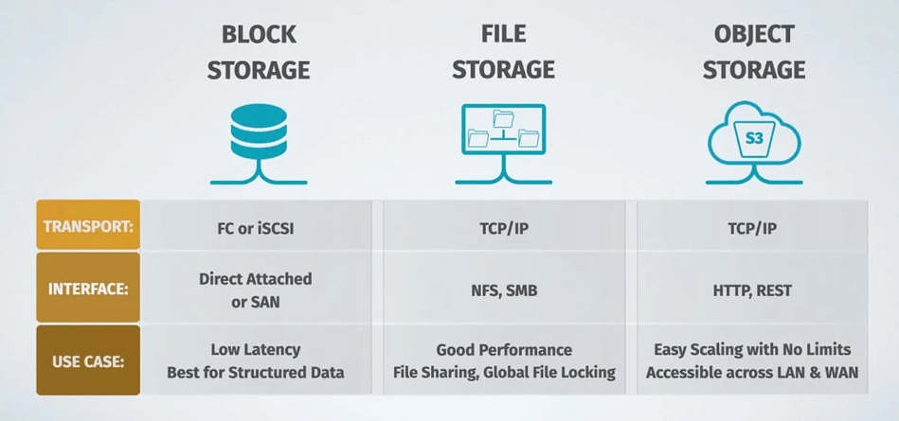
Storage Type

Slide 4
File storage:
File storage stores data in folders also known as hierarchical storage, simulates how paper documents are stored.
When data needs to be accessed, a computer system must look for it using its path in the folder structure.
File storage uses TCP/IP as its transport, and devices typically use the NFS protocol in Linux and SMB in Windows.

Slide 5
Block storage:
Block storage splits a file into separate data blocks, and stores each of these blocks as a separate data unit.
Each block has an address, and so the storage system can find data without needing a path to a folder.
This also allows data to be split into smaller pieces and stored in a distributed manner.
Whenever a file is accessed, the storage system software assembles the file from the required blocks.
Block storage uses FC or iSCSI for transport, and devices operate as direct attached storage or via a storage area network (SAN).

Slide 6
Object storage:
Data blocks that make up a file or “object”, together with its metadata, are all kept together.
Extra metadata is added to each object, which makes it possible to access data with no hierarchy.
All objects are placed in a unified address space. In order to find an object, users provide a unique ID.
Object-based storage uses TCP/IP as its transport, and devices communicate using HTTP and REST APIs.
Metadata is determined by the user, and allows flexible analysis and retrieval of the data in a storage pool, based on its function and characteristics.
advantage of object storage is that you can group devices into large storage pools, and distribute those pools across multiple locations.
This not only allows unlimited scale, but also improves resilience and high availability of the data.

Slide 7
Object Storage Architecture: How Does It Work?
Object storage can be implemented at the device level, system level, and interface level.
Many of the cloud storage options currently on the market utilize an object-storage architecture, including AWS, Azure, Google Cloud, and more.
Each piece of data is stored as an object, which contains both the data itself and a unique identifier, known as an object ID.
This ID allows the system to locate and retrieve the object without relying on hierarchical file structures or block mappings, enabling faster and more efficient data access.
Object storage architecture typically consists of three main components:
The data storage layer,
The metadata index, and
The API layer.

Slide 8
Data Storage Layer:
The data storage layer is where the actual data objects are stored.
Data is typically distributed across multiple storage nodes to ensure high performance, durability, and redundancy.
Each storage node typically contains a combination of hard disk drives (HDDs) and solid-state drives (SSDs) to provide the optimal balance between capacity, performance, and cost.
Data objects are automatically replicated across multiple nodes, ensuring that data remains available and protected even in the event of hardware failures or other disruptions.

Slide 9
Metadata Index
It maintains a record of each object’s unique identifier, along with other relevant metadata, such as access controls, creation date, and size.
This information is stored separately from the actual data, allowing the system to quickly and efficiently locate and retrieve objects based on their metadata attributes.
The metadata index is designed to be highly scalable, enabling it to support millions or even billions of objects within a single object storage system.

Slide 10
API Layer:
The API layer is responsible for providing access to the object storage system, allowing users and applications to store, retrieve, and manage data objects.
Most object storage systems support a variety of standardized APIs, such as the Simple Storage Service (S3) API from Amazon Web Services (AWS), the OpenStack Swift API, and the Cloud Data Management Interface (CDMI).
These APIs enable developers to easily integrate object storage into their applications, regardless of the underlying storage technology or vendor.

Slide 11
Object Storage Benefits
Exabyte Scalable
Scale Out Architecture
Customizable Metadata
High Sequential Throughput Performance
Flexible Data Protection Options
Support for the S3 API
Lower Total Cost of Ownership (TCO)
Object Storage Use Cases
Backup and archiving
Big data analytics
Media storage and delivery
Internet of Things (IoT)

Slide 12
Distributed Object Storage
As data volumes continue to increase throughout all industries exponentially, new storage solutions are required to support this growth.
Through the use of distributed object storage, data can be spread across a variety of servers allowing for higher availability, backup solutions, and disaster recovery abilities.

Slide 13
Distributed Object Storage
Distributed storage includes hardware and software enabling a scale-out distributed file system technology targeted at unstructured data growth.
Data can be split across various physical servers and multiple data centers.
It generally utilizes a cluster of storage units with synchronization and coordination methods between nodes.
Distributed storage is one of the foundational technologies for cloud service providers and on-premises distributed storage systems.
Distributed storage can handle file storage, block storage, and object storage.
Common features of distributed storage include
Distributing data between clusters, known as partitioning, and
Replicating data across clusters to maintain consistency.
Distributed storage also has fault tolerance features where availability is maintained in case a cluster goes down, in addition to elastic scalability, the system can scale up and down with more storage if necessary.

Slide 14
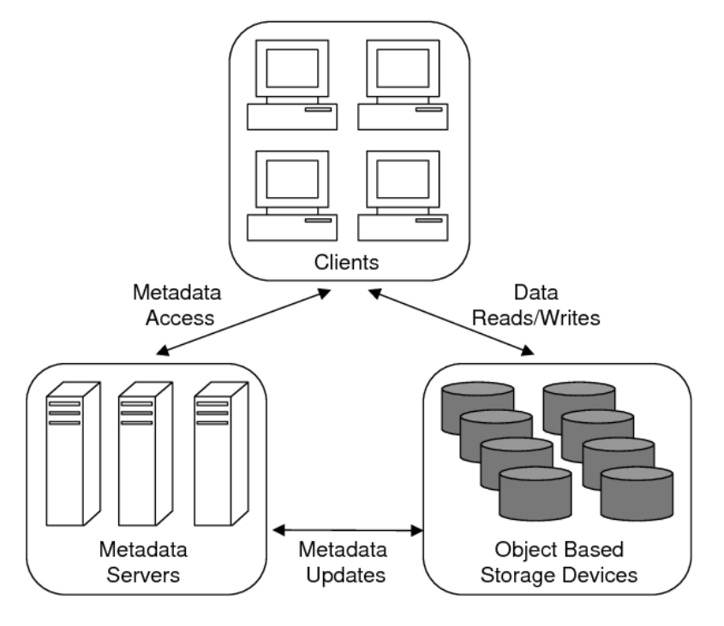
Fig: Distributed Object Storage system architecture

Slide 15
How to Choose an Object-Based Storage Solution
Scalability
Data durability and protection
Cost
Performance
Integration and compatibility

Slide 16
Object Query Processing

